Slide 1

Database and Dashboard Project
In partnership with the Get Outside Alliance
Sami Elshafie
Charaf Lachouri
Kevin Maldonado
Tatiana Uklist
Tanner Waggoner
TCOM 5340
University of Houston - Downtown
February 15, 2023

Slide 2
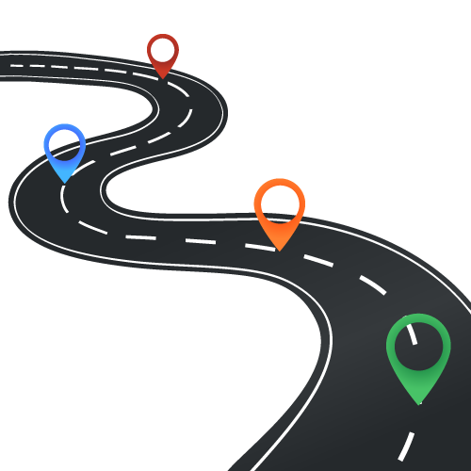




We will create a database, dashboard, and documentation for the Get Outside Alliance to understand and use their volunteer data.
Requirements
Objectives
Milestones
Deliverables
Team
This Photo by Unknown Author is licensed under CC BY-SA

Slide 3
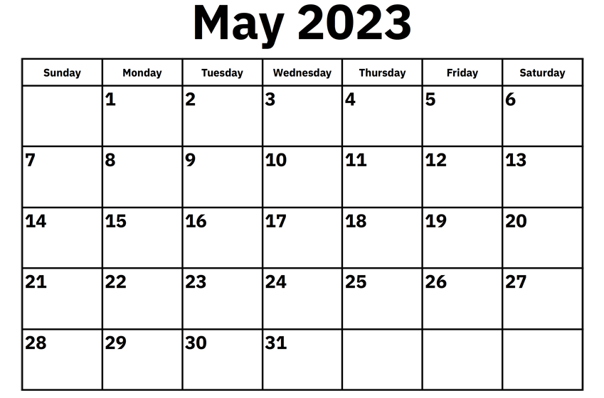



Our client has four requirements for this database and dashboard project.
Finished by 5/12/23
Data is current and organized
No cost to client
Project is well documented for continued use
This Photo by Unknown Author is licensed under CC BY-SA-NC

Slide 4
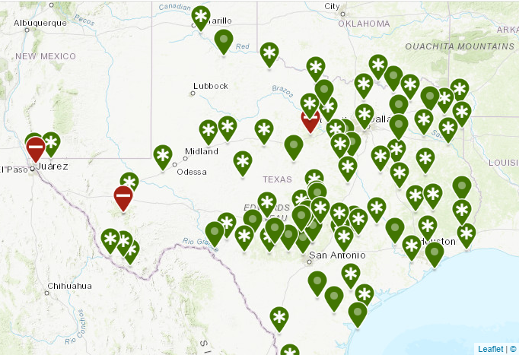
These objectives need to be met for us to give the Get Outside Alliance the best tools to understand and use the data on their volunteers.
1. Research State Parks within parameters Notice I removed the center justification here and on #4
2. Gather necessary data
3. Create automated visualization
4. Document processes needed to maintain

Slide 5
Milestones drive projects to completion and keep teams on task This is a description of the function of milestones. You should instead state that the project will be divided up according to tasks, individual strengths or expertise, etc. Also, I would align the left side of the graphic with the beginning of the title
Submit project plan
March 29th
Compiled list of state parks
April 7th
Visualization software decided on
April 12th
Data visualization finished
Deliverables finalized and submitted
April 30th
May 12th

Slide 6
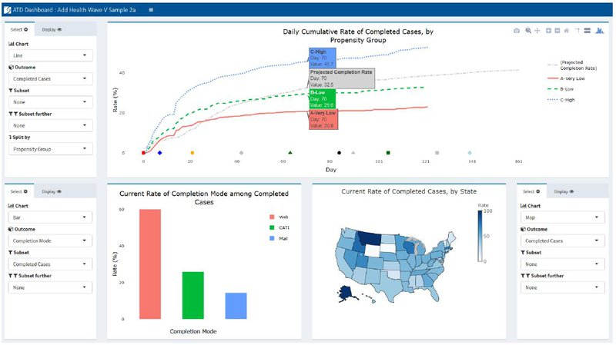
Data in clear documents and visuals will help our clients create more advocates for the Texas State Park and Wildlife System.
Silver
Cross
Red

Slide 7
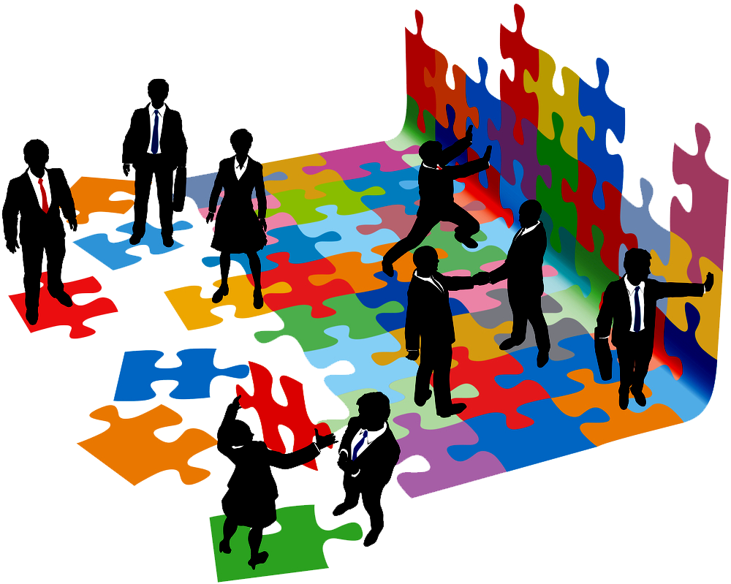
The team is responsible for the project’s success. Claim: We have the expertise to produce deliverables that will met your expectations
Tanner Waggoner: Documentation and Data
Kevin Maldonado:
Visualization and database
Sami Elshafie:
Data specialist
Tatiana Uklist:
Project Manager
Charaf Lachouri:
Data specialist
This Photo by Unknown Author is licensed under CC BY-NC

